Slide 1


Advanced Topics
Travis Hance (and the Verus Team)
CMU
MPI-SWS (to join soon)
https://verus.rs/

Slide 2
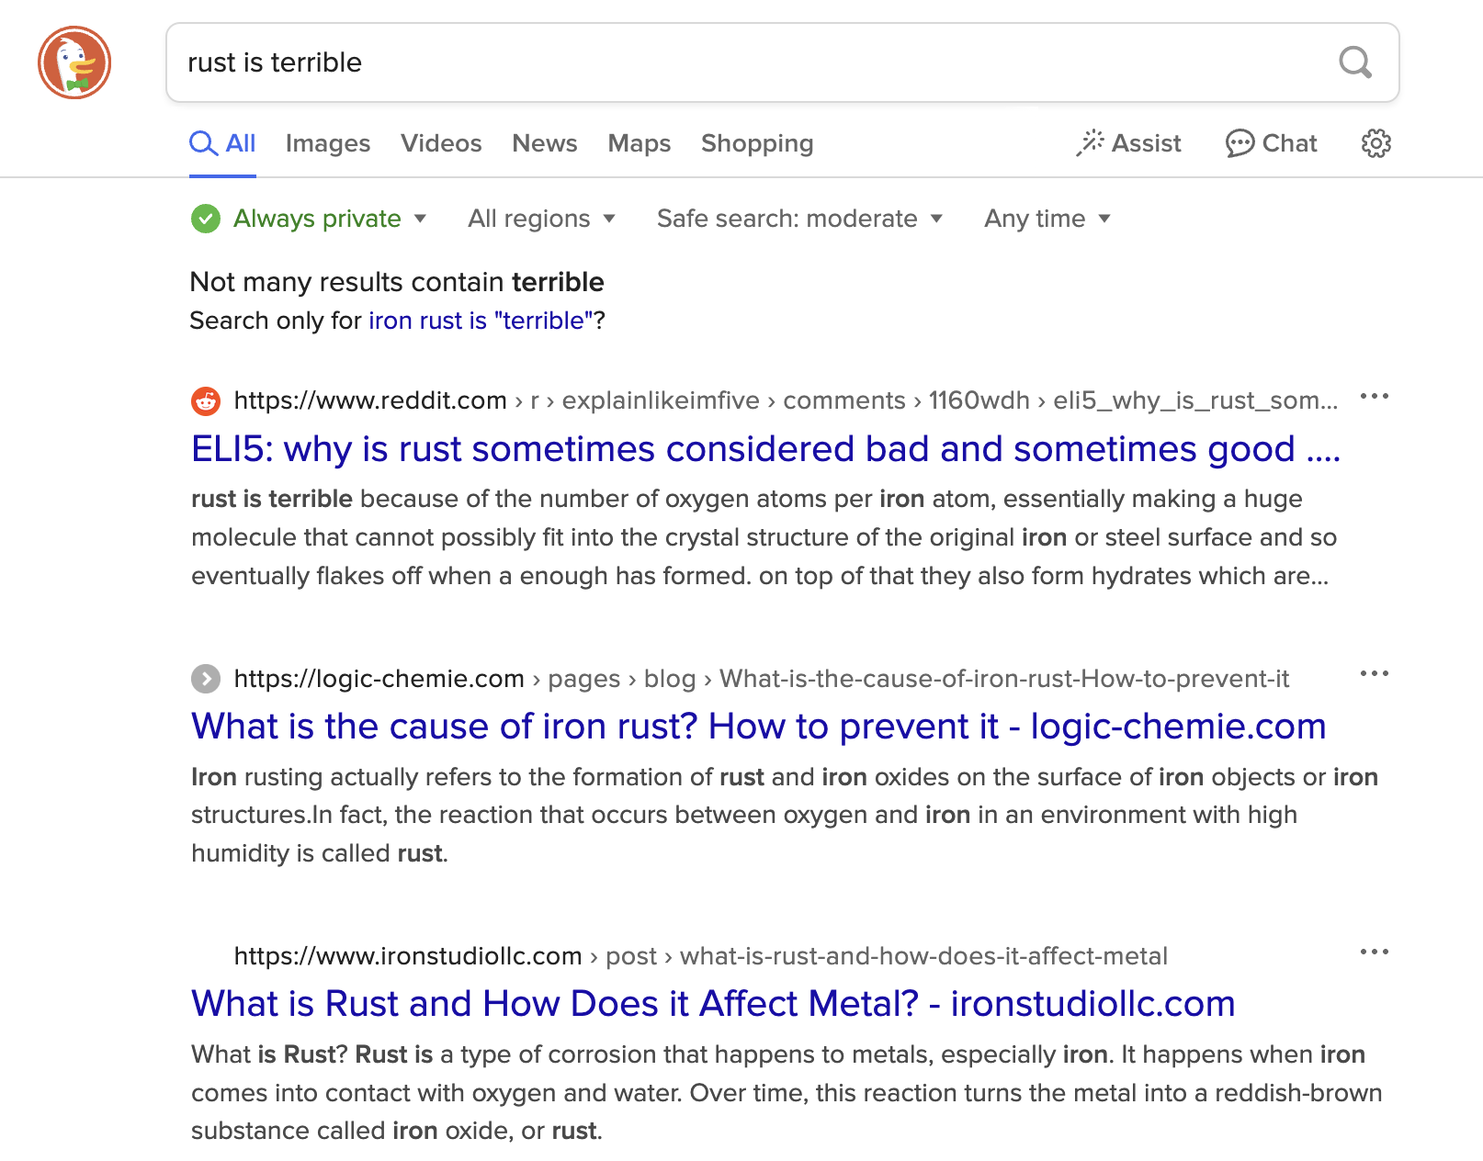
Rust has a lot of restrictions
I’m always fighting the borrow-checker!
Why can’t the compiler get out of my way?
Notes:
Rust is widely known to have a lot of restrictions. These restrictions are actually pretty good for verification …
This morning, we stuck to those restrictions, and Verus works pretty well when you do
But there are ways to bend those restrictions …

Slide 3

Unsafe Code
Interior mutability
Notes:
I’m going to be talking about 3 big topics today – interior mutability, unsafe code, and concurrency
[poll audience if they know what interior mutability, unsafe code are]
These 3 topics are actually highly interrelated, in that any code using 1 of them is very likely using 1 of the others as well. To verify significant systems requires us to be proficient in the art of composing all the related concepts. For this talk, though, I’ll try to distill each to its essence and a present a self-contained introduction to each, at least for the first 2.

Slide 4
Unsafe Code

Slide 5

What is unsafe code?
Definition attempt #1:
Unsafe code is code that opts the programmer out of the memory-safety guaranteed by Rust’s type system
fn oh_no() {
let p: *mut u64 = std::ptr::null_mut();
unsafe {
*p = 20;
}
}

Slide 6
What is unsafe code?
Definition attempt #1:
Unsafe code is code that opts the programmer out of the memory-safety guaranteed by Rust’s type system
fn oh_no() {
let p: *mut u64 = std::ptr::null_mut();
unsafe {
*p = 20;
}
}
This seems pretty bad — doesn’t Verus rely on this?

Slide 7

Let’s think a little more positively

Slide 8
What is unsafe code?
Definition attempt #2:
Unsafe code is code that has additional requirements (beyond Rust’s type checker) to guarantee memory safety

Slide 9
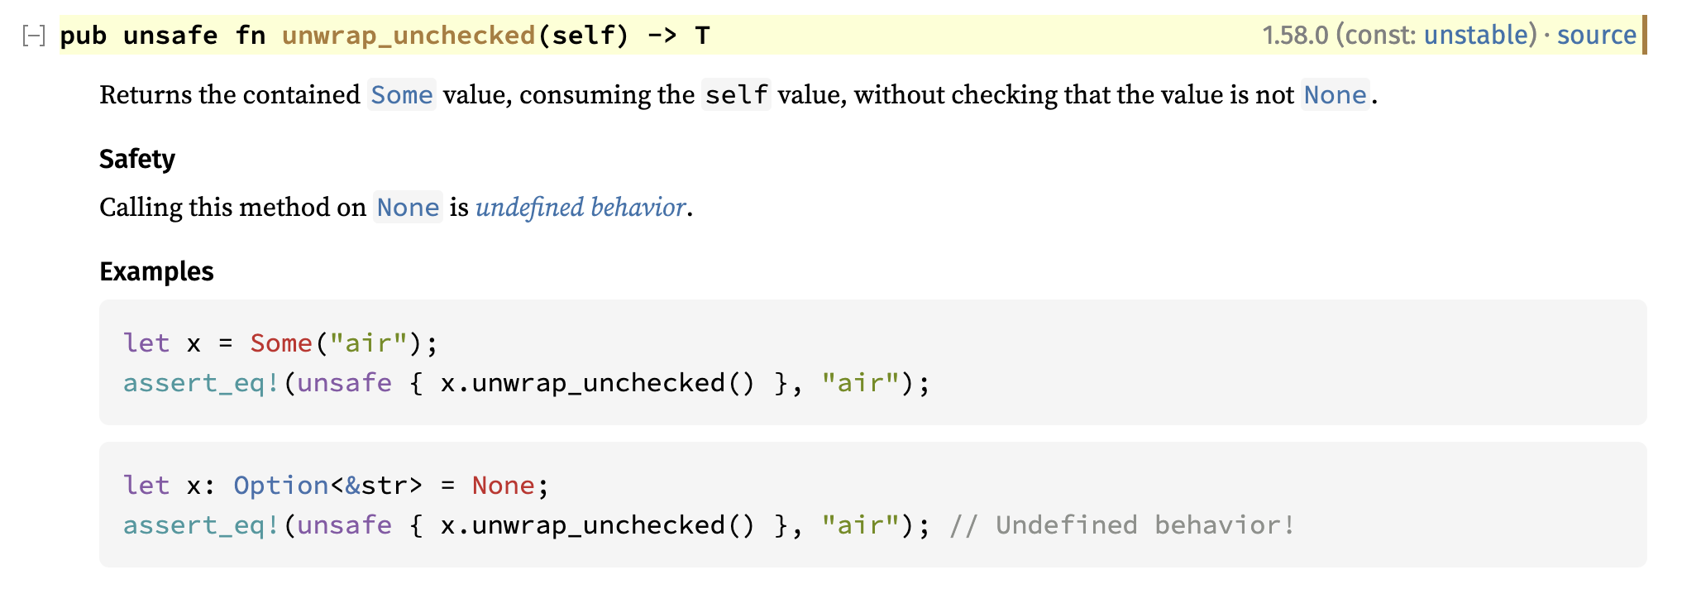
Example: Option::unwrap_unchecked
The subtext here is that behavior is defined if self is Some(_)
https://doc.rust-lang.org/std/option/enum.Option.html#method.unwrap_unchecked

Slide 10
What is unsafe code?
Unsafe code is really Conditionally Safe code — if the condition is satisfied, then it is safe
impl<T> Option<T> {
fn unwrap_unchecked(self) -> (res: T)
requires self.is_some()
ensures self == Some(res)
{
/* ... */
}
}
These conditions can be made explicit and formal using Verus preconditions

Slide 11
Unsafe Code

Slide 12

Unsafe Code
Notes:
Put this way, unsafe code doesn’t sound so bad. “Unsafe code” just means it has a requires clause, which is what you all have been practicing with all day. But —

Slide 13

Unsafe pointers

Slide 14
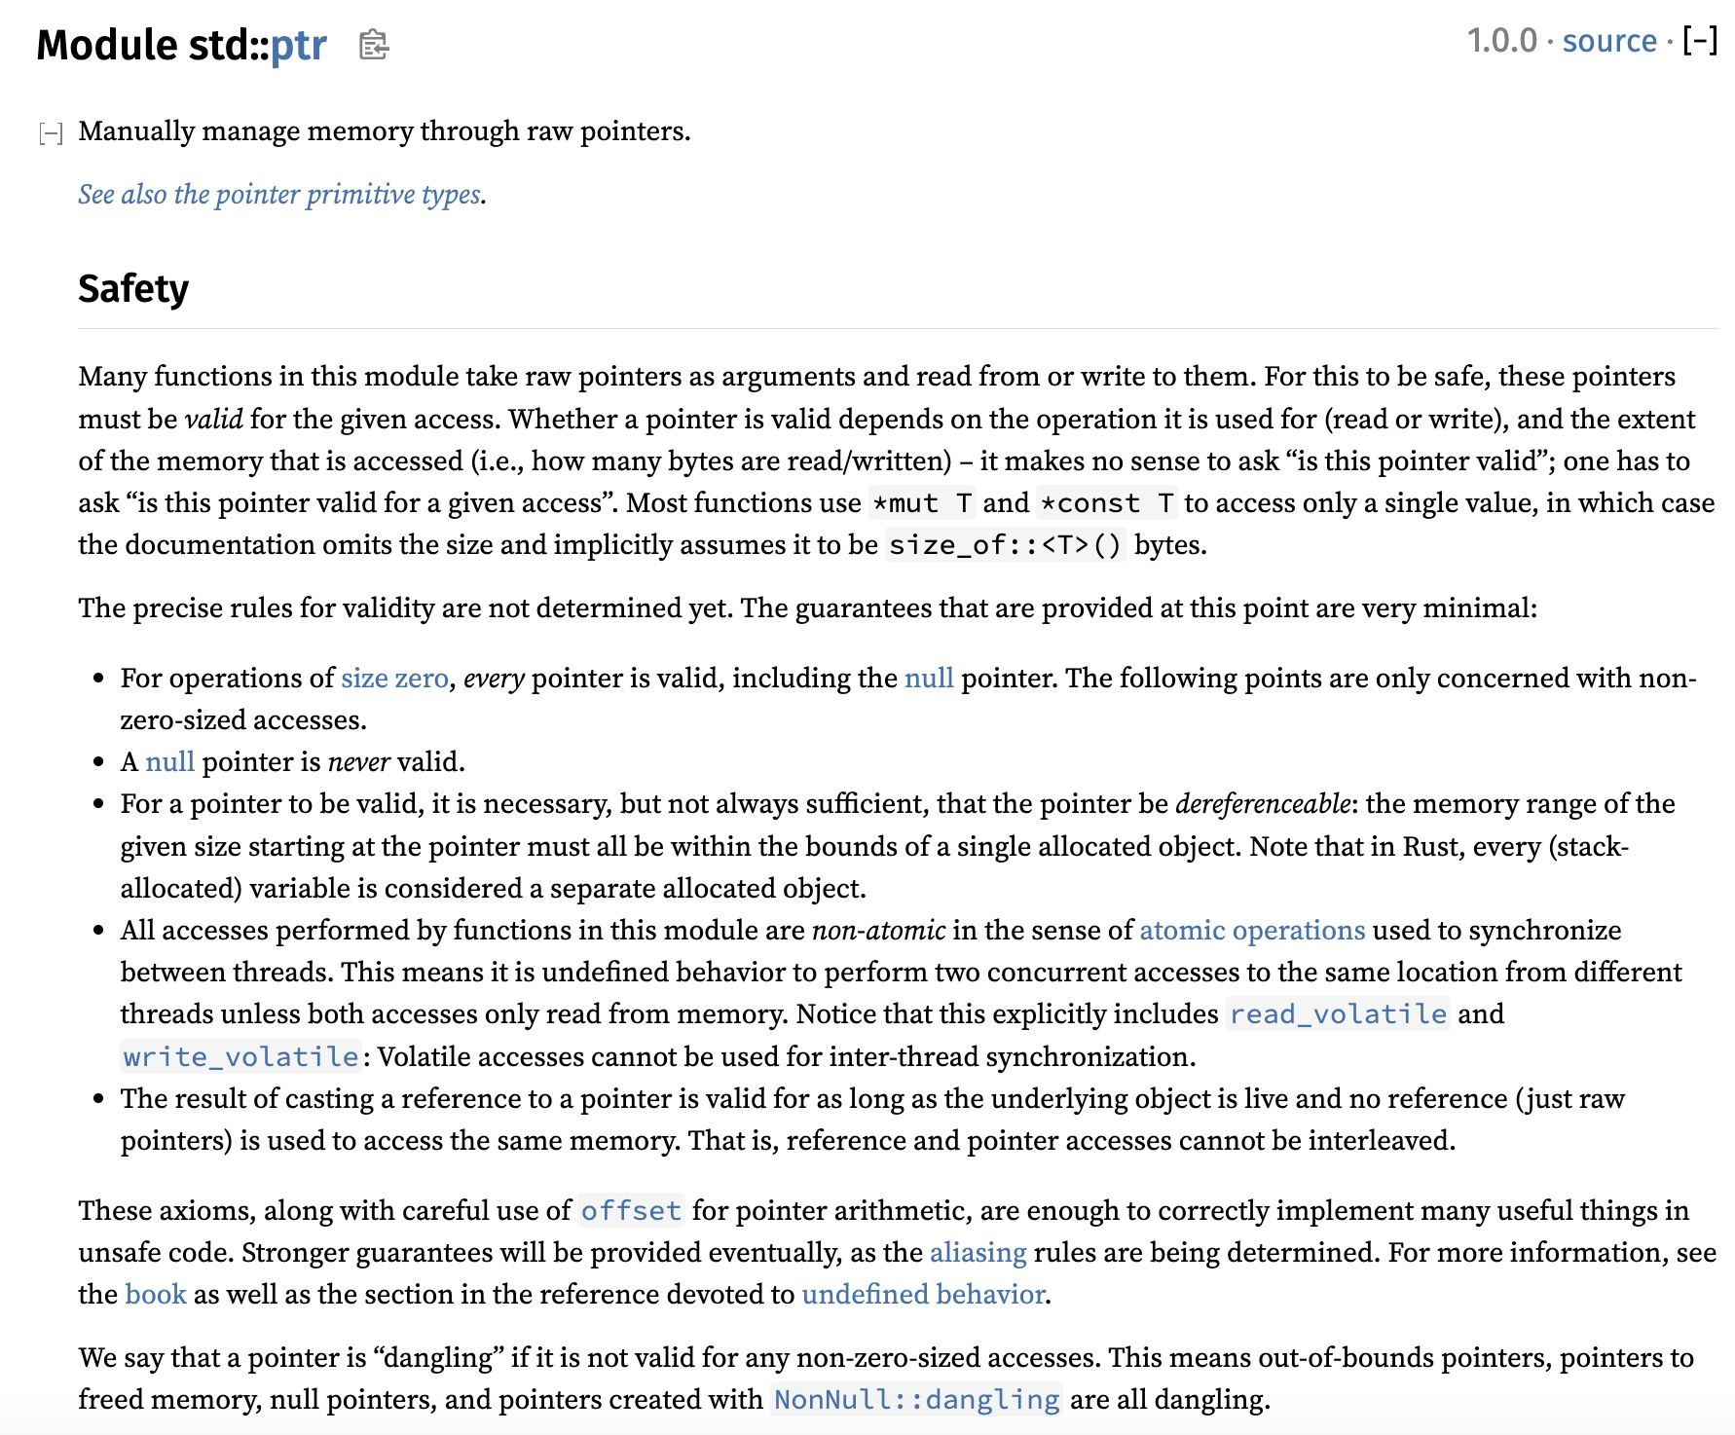
Let’s check the docs again

Slide 15
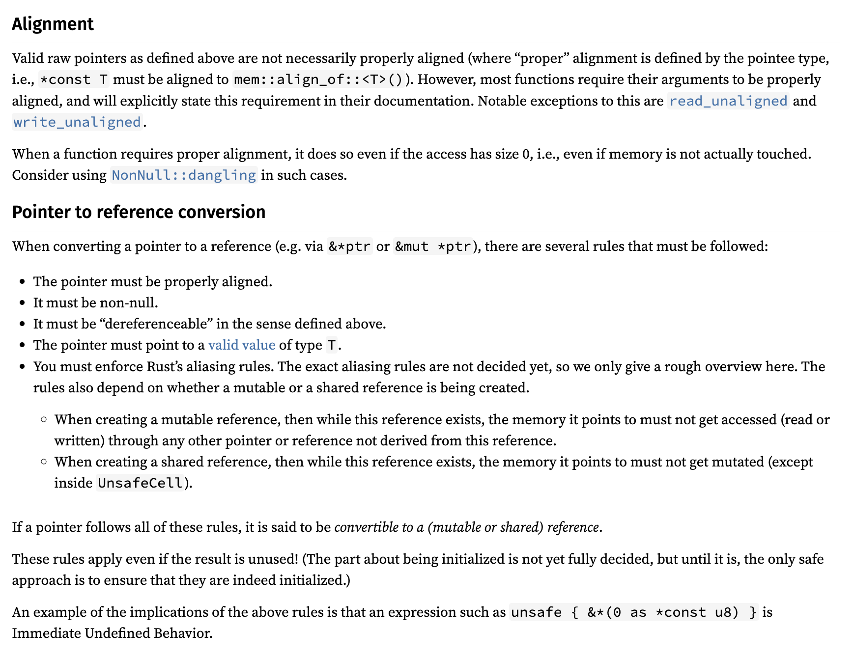
Let’s check the docs again

Slide 16
Let’s check the docs again
It keeps going, by the way

Slide 17
Pointers have a lot of conditions
Accessing a pointer requires:
Memory is valid, allocated, well-aligned
Reads must be initialized
Accesses are data-race-free
Playing nice with reference system (&T and &mut T)
Handling “pointer provenance”
Can these conditions even be expressed via Verus preconditions?

Slide 18

Isn’t this what ownership types are for?
Ordinarily, Rust’s type system, together with its clever standard library types (&T, &mut T, Box<T>, Rc<T>, Arc<T>, RefCell<T>, …), ensure that all the rules are followed
But the whole point of using “raw pointers” is that we can’t use those types…
Now we’re just going in circles!
Notes:
The point is that Rust does have the capability to cleanly reason about these concepts, it’s just slightly out of reach. We need to grasp a little farther.

Slide 19
Isn’t this what ownership types are for?
Ordinarily, Rust’s type system, together with its clever standard library types (&T, &mut T, Box<T>, Rc<T>, Arc<T>, RefCell<T>, …), ensure that all the rules are followed
But the whole point of using “raw pointers” is that we can’t use those types…
Solution: Decouple the ownership reasoning from the physical pointers; reason about ownership in “proof code”

Slide 20
Pointers have a lot of conditions
Accessing a pointer requires:
Memory is valid, allocated, well-aligned
Reads must be initialized
Accesses are data-race-free
Place nice with reference system (&T and &mut T)
Handling “pointer provenance”
For the demo & exercise, we’ll use Verus’s “Simple PPtr” library, which sands down the rougher edges at the cost of generality — but it still covers the key points

Slide 21
[PPtr demo]

Slide 22
Recap
In general, “unsafe code” is actually Conditionally Safe
i.e., it has a requires clause
However, for advanced cases like raw pointers, safety comes from a combination of this requires clause with complex ownership reasoning
We can handle this ownership reasoning in proof code, without tying it to the physical types

Slide 23
Recap
Safety ensured by preconditions
Safety ensured by ownership types
&mut T
Option::unwrap_unchecked
&T
Raw ptrs
Box<T>
Arc<T>
Rc<T>
“Unsafe code”
“Safe code”

Slide 24
Interior mutability

Slide 25

What is interior mutability?
Rust’s references are usually described to new users as follows:
Type
&mut T | Unique | Mutable
&T | Shared | Immutable
Unfortunately it’s not entirely correct …
Sometimes described as “shared XOR mutable,” this is an important property that enables Rust’s memory safety & Verus’s efficient SMT encoding

Slide 26
What is interior mutability?
Interior mutability is a pattern wherein you can modify data behind a shared reference (&).
However, this is only possible through specialized “interior mutability” types (e.g., Cell, RefCell, Mutex, RwLock, UnsafeCell)
This is good, because unrestricted mutation-through-& would ruin all the theory behind Verus’s encoding
As it is, we can restrict the additional complexity only to when these specialized types are involved

Slide 27
What’s the problem?
fn example(cell1: &Cell<u64>, cell2: &Cell<u64>)
-> (u64, u64)
{
cell1.set(24);
cell2.set(25);
let x = cell1.get();
let y = cell2.get();
(x, y)
}
cell1 = 24
cell2 = 25
x = 24
y = 25
(x, y) = (24, 25)
Notes:
This is obviously wrong … if it seems laughably naïve to you, though, I want to emphasize that this is basically how Verus works 90% of the time, when you’re working with “normal” reference types

Slide 28
What’s the problem?
fn example(cell1: &Cell<u64>, cell2: &Cell<u64>)
-> (u64, u64)
{
cell1.set(24);
cell2.set(25);
let x = cell1.get();
let y = cell2.get();
(x, y)
}
cell1 = 24
cell2 = 25
x = 24
y = 25
(x, y) = (24, 25)
But (25, 25) is possible!
Notes:
This is obviously wrong … if it seems laughably naïve to you, though, I want to emphasize that this is basically how Verus works 90% of the time, when you’re working with “normal” reference types

Slide 29
What’s the problem?
fn example(cell1: &Cell<u64>, cell2: &Cell<u64>)
-> (u64, u64)
{
cell1.set(24);
cell2.set(25);
let x = cell1.get();
let y = cell2.get();
(x, y)
}
Option 1: Maintain a “cell heap”
Heap = [ cell1 |--> 24 ; cell2 |--> 25 ]
(and cell1 ≠ cell2)
Or
Heap = [ cell1 |--> 25]
(and cell1 = cell2)
This “leaks” the mutability everywhere

Slide 30

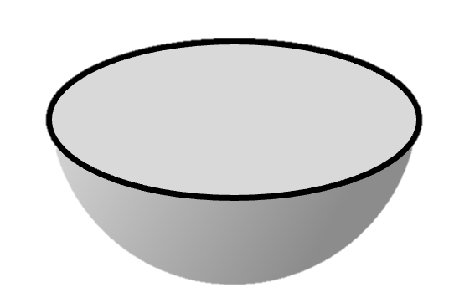
Our goal is to encapsulate mutation
The whole point of interior mutability is to “pretend” that something mutable is immutable.
Verification should reflect that.
&mut T
Let’s do an example to see why we care

Slide 31
Example: Memoizing a deterministic fn
Suppose we have some expensive but deterministic computation
pub fn expensive_function(args: &Args) -> Output {
/* ... */
}
struct Memoizer {
map: HashMap<Args, Output>
}
impl Memoizer {
pub fn get(&mut self, args: &Args) -> Output {
match self.map.get(args) {
Some(result) => result.clone(),
None => {
// Compute for the first time and store the result for next time
let result = expensive_function(args);
self.map.insert(args.clone(), result.clone());
result
}
}
}
}
We can memoize the results — lazily populate a lookup-table of results, as-needed

Slide 32
Example: Memoizing a deterministic fn
Now, what if we want to share the Memoizer across multiple subsystems? Maybe even across threads?
Arc<Memoizer> → &Memoizer
Whoops, now we can’t call get —
fn get(&mut self, args: &Args)

Slide 33
Example: Memoizing a deterministic fn
pub fn expensive_function(args: &Args) -> Output {
/* ... */
}
struct Memoizer {
map: HashMap<Args, Output>
}
impl Memoizer {
pub fn get(&mut self, args: &Args) -> Output {
match self.map.get(args) {
Some(result) => result.clone(),
None => {
// Compute for the first time and store the result for next time
let result = expensive_function(args);
self.map.insert(args.clone(), result.clone());
result
}
}
}
}

Slide 34
Example: Memoizing a deterministic fn
We really want to implement this instead:
fn get(&self, args: &Args)
For this we can use interior mutability …

Slide 35
Example: Memoizing a deterministic fn
pub fn expensive_function(args: &Args) -> Output {
/* ... */
}
struct Memoizer {
ref_cell: RefCell<HashMap<Args, Output>>
}
impl Memoizer {
pub fn get(&self, args: &Args) -> Output {
let map_handle = self.ref_cell.borrow_mut();
match map_handle.get(args) {
Some(result) => result.clone(), None => {
// Compute for the first time and store the result for next time
let result = expensive_function(args);
map_handle.insert(args.clone(), result.clone());
result
}
}
}
}

Slide 36
Example: Memoizing a deterministic fn
Now we have this beautiful type signature that hides the mutability:
fn get(&self, args: &Args)
The Verus specification should be equally concise:
no “modifies” clause
no passing in “write-permissions”
etc.
&mut T

Slide 37
Solution: What doesn’t change?
If Verus can’t treat like &Cell<u64> as a u64 because the u64 might change … let’s treat it like something that doesn’t change
What doesn’t change? An invariant.
Bonus: Invariants work well with locks, too.

Slide 38
Interior mutability types
Cell
RefCell
Mutex
RwLock

Slide 39
Interior mutability types
Cell
RefCell
Mutex
RwLock
For single-threaded use

Slide 40
Interior mutability types
Cell
RefCell
Mutex
RwLock
For single-threaded use
Thread-safe; for multi-threaded use
Spectrum of trade-offs in terms of overhead / flexibility

Slide 41
[RwLock demo]

Slide 42
An encapsulating specification
pub spec fn func(args: &Args) -> Output { ... }
pub fn expensive_function(args: &Args) -> (output: Output)
ensures output == func(args)
{ ... }
impl Memoizer {
pub fn get(&self, args: &Args) -> (output: Output)
ensures output == func(args)
{ ... }
}
Function must be deterministic
Memoizer is deterministic and computes the same function

Slide 43
An encapsulating specification
pub spec fn func(args: &Args) -> Output { ... }
pub fn expensive_function(args: &Args) -> (output: Output)
ensures output == func(args)
{ ... }
impl Memoizer {
pub fn get(&self, args: &Args) -> (output: Output)
ensures output == func(args)
{ ... }
}
Function must be deterministic
Memoizer is deterministic and computes the same function
Observe again how the mutation is encapsulated

Slide 44
Recap
Interior mutability carves an exception to the usual “sharing XOR mutability” dichotomy of Rust, which Verus relies on
Thus, interior mutability adds complexity, but that complexity can be encapsulated
To do this, we can use lock invariants / cell invariants

Slide 45
Notes:
Rope font is from: https://www.fontspace.com/category/rope

Slide 46
We already covered locks actually …
But one big global lock does not concurrency make!
Notes:
A global lock is _multi-threaded_ but it isn’t truly concurrent.

Slide 47
Realistic systems use fine-grained locks

Slide 48
Realistic systems use fine-grained locks
We can talk about the invariant on a single lock

Slide 49
Realistic systems use fine-grained locks
We can talk about the invariant on a single lock
But how do we relate all the locks together?

Slide 50
Problem: split ownership
True Concurrency requires us to have multiple components that can be owned and operated independently
Problem: How do we reason about the system if we don’t have ownership of the whole thing?

Slide 51

But how do we reason globally?
We need an invariant that “reaches across space”

Slide 52
Example 2: Producer/consumer queue
Thread 1
Thread 2
Thread 3
Thread 4
Producer
Producer
Producer
Producer
Queue data is shared
Queue Buffer
Consumer
Consumer
Consumer
Consumer
Thread 5
Thread 6
Thread 7
Thread 8
Individual “handles” are owned by threads
9 separately owned objects that need to coordinate somehow …

Slide 53
Example 2: Producer/consumer queue
Thread 1
Thread 2
Thread 3
Thread 4
These components, owned by different threads, need to coordinate somehow
Producer
Producer
Producer
Producer
Queue Buffer
Consumer
Consumer
Consumer
Consumer
Thread 5
Thread 6
Thread 7
Thread 8

Slide 54
Example 3: “Agreement”
fn update_pair(mut token0: Token,
mut token1: Token, new_value: u64
) -> (pair: (Token, Token))
requires token0.id == token1.id
ensures
pair.0.value == new_value,
pair.1.value == new_value,
pair.0.id == token0.id,
pair.1.id == token1.id,
{
token0.value = new_value;
token1.value = new_value;
(token0, token1)
}
fn validate_pair(token0: &Token, token1: &Token)
requires token0.id == token1.id
ensures token0.value == token1.value
{
/* ? */
}
struct Token {
id: Id,
value: u64
}
fn new_pair(value: u64) -> (pair: (Token, Token))
ensures
pair.0.id == pair.1.id,
pair.0.value == value,
pair.1.value == value,
{
let id = fresh_id();
(Token { id: id, value: value },
Token { id: id, value: value })
}

Slide 55
Example 3: “Agreement”
fn update_pair(mut token0: Token,
mut token1: Token, new_value: u64
) -> (pair: (Token, Token))
requires token0.id == token1.id
ensures
pair.0.value == new_value,
pair.1.value == new_value,
pair.0.id == token0.id,
pair.1.id == token1.id,
{
token0.value = new_value;
token1.value = new_value;
(token0, token1)
}
fn validate_pair(token0: &Token, token1: &Token)
requires token0.id == token1.id
ensures token0.value == token1.value
{
/* ? */
}
struct Token {
id: Id,
value: u64
}
fn new_pair(value: u64) -> (pair: (Token, Token))
ensures
pair.0.id == pair.1.id,
pair.0.value == value,
pair.1.value == value,
{
let id = fresh_id();
(Token { id: id, value: value },
Token { id: id, value: value })
}

Slide 56
Example 3: “Agreement”
fn update_pair(mut token0: Token,
mut token1: Token, new_value: u64
) -> (pair: (Token, Token))
requires token0.id == token1.id
ensures
pair.0.value == new_value,
pair.1.value == new_value,
pair.0.id == token0.id,
pair.1.id == token1.id,
{
token0.value = new_value;
token1.value = new_value;
(token0, token1)
}
fn validate_pair(token0: &Token, token1: &Token)
requires token0.id == token1.id
ensures token0.value == token1.value
{
/* ? */
}
struct Token {
id: Id,
value: u64
}
fn new_pair(value: u64) -> (pair: (Token, Token))
ensures
pair.0.id == pair.1.id,
pair.0.value == value,
pair.1.value == value,
{
let id = fresh_id();
(Token { id: id, value: value },
Token { id: id, value: value })
}

Slide 57
Example 3: “Agreement”
fn update_pair(mut token0: Token,
mut token1: Token, new_value: u64
) -> (pair: (Token, Token))
requires token0.id == token1.id
ensures
pair.0.value == new_value,
pair.1.value == new_value,
pair.0.id == token0.id,
pair.1.id == token1.id,
{
token0.value = new_value;
token1.value = new_value;
(token0, token1)
}
fn validate_pair(token0: &Token, token1: &Token)
requires token0.id == token1.id
ensures token0.value == token1.value
{
/* ? */
}
struct Token {
id: Id,
value: u64
}
fn new_pair(value: u64) -> (pair: (Token, Token))
ensures
pair.0.id == pair.1.id,
pair.0.value == value,
pair.1.value == value,
{
let id = fresh_id();
(Token { id: id, value: value },
Token { id: id, value: value })
}

Slide 58
Example 3: “Agreement”
fn update_pair(mut token0: Token,
mut token1: Token, new_value: u64
) -> (pair: (Token, Token))
requires token0.id == token1.id
ensures
pair.0.value == new_value,
pair.1.value == new_value,
pair.0.id == token0.id,
pair.1.id == token1.id,
{
token0.value = new_value;
token1.value = new_value;
(token0, token1)
}
fn validate_pair(token0: &Token, token1: &Token)
requires token0.id == token1.id
ensures token0.value == token1.value
{
/* ? */
}
struct Token {
id: Id,
value: u64
}
fn new_pair(value: u64) -> (pair: (Token, Token))
ensures
pair.0.id == pair.1.id,
pair.0.value == value,
pair.1.value == value,
{
let id = fresh_id();
(Token { id: id, value: value },
Token { id: id, value: value })
}

Slide 59
Example 3: “Agreement”
fn update_pair(mut token0: Token,
mut token1: Token, new_value: u64
) -> (pair: (Token, Token))
requires token0.id == token1.id
ensures
pair.0.value == new_value,
pair.1.value == new_value,
pair.0.id == token0.id,
pair.1.id == token1.id,
{
token0.value = new_value;
token1.value = new_value;
(token0, token1)
}
fn validate_pair(token0: &Token, token1: &Token)
requires token0.id == token1.id
ensures token0.value == token1.value
{
/* ? */
}
struct Token {
id: Id,
value: u64
}
fn new_pair(value: u64) -> (pair: (Token, Token))
ensures
pair.0.id == pair.1.id,
pair.0.value == value,
pair.1.value == value,
{
let id = fresh_id();
(Token { id: id, value: value },
Token { id: id, value: value })
}
Who maintains this invariant?

Slide 60
Verus’s System: VerusSync
Provides a means for “space-reaching invariants”
Acknowledges that real systems need invariants a little more complicated than two-party agreement.

Slide 61
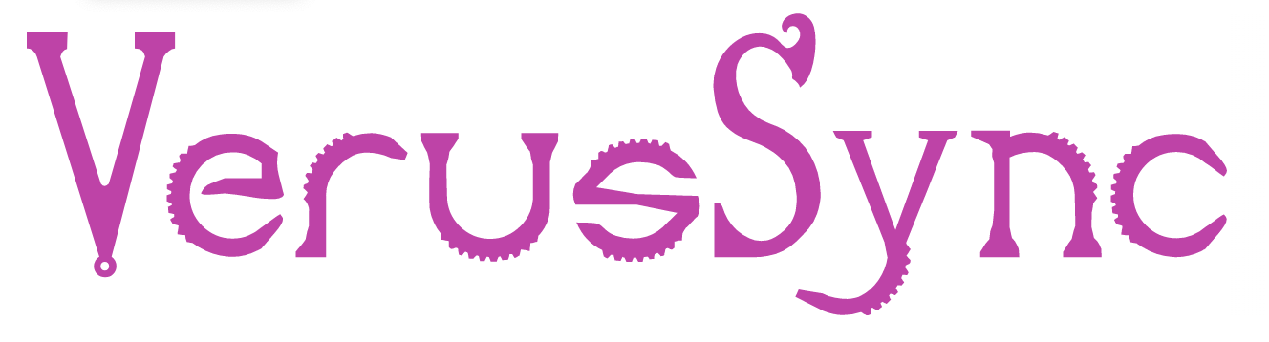
Verus’s System: VerusSync
VerusSync provides:
Ghost objects (like PointsTo)
Developer defines:
State
VerusSync
Operations
Invariants
With a space-reaching invariants

Slide 62
Verus’s System: VerusSync

Slide 63
Verus’s System: VerusSync
You can connect the ghost state to other state you care about via more lock invariants

Slide 64

Notes:
The space-reaching invariant reaches through the ”ghost dimension”

Slide 65
[Demo: VerusSync]

Slide 66

Recap
Memory permissions
Space-reaching invariants
Lock invariants

